Slide 1
Decentralized Identifiers and the Eclipse Dataspace Connector
Stefan van der Wiele
Senior Program Manager
Microsoft Identity Division
@wiele

Slide 2
What are we trying to solve?
Each participant should remain in control of their own identity and who they trust
No single kill switch
Decentralized identity without the need for distributed ledger

Slide 3
Quick overview
What is a Verifiable Credential, Decentralized Identifier?
What is an Identity Hub?

Slide 4
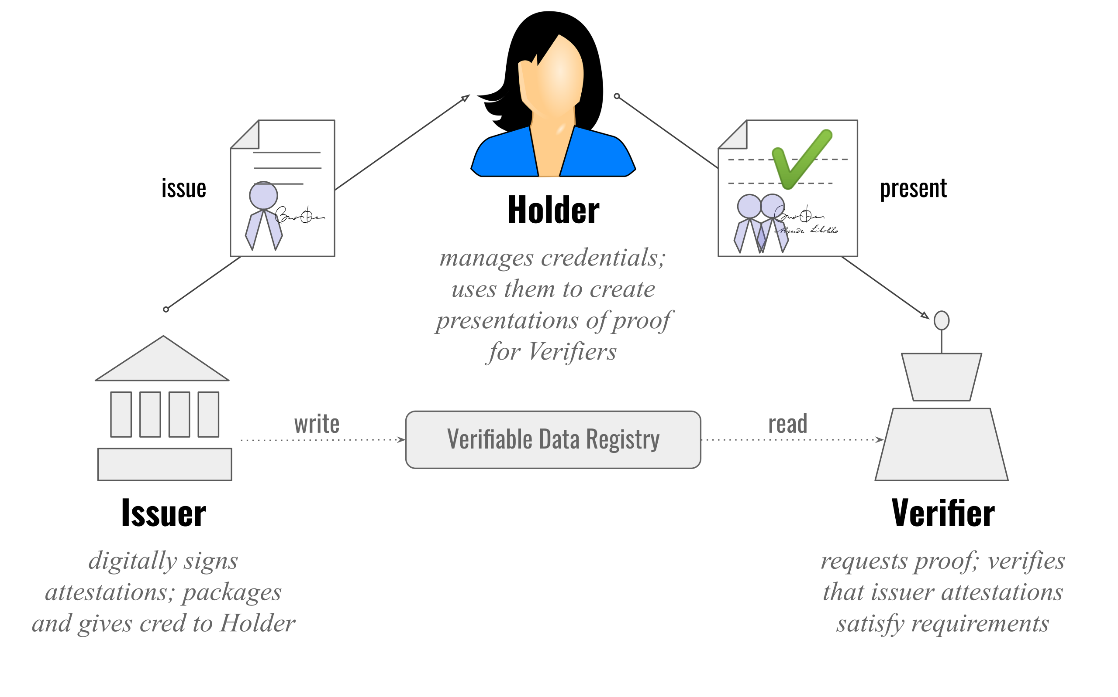
W3C Verifiable Credentials

Slide 5
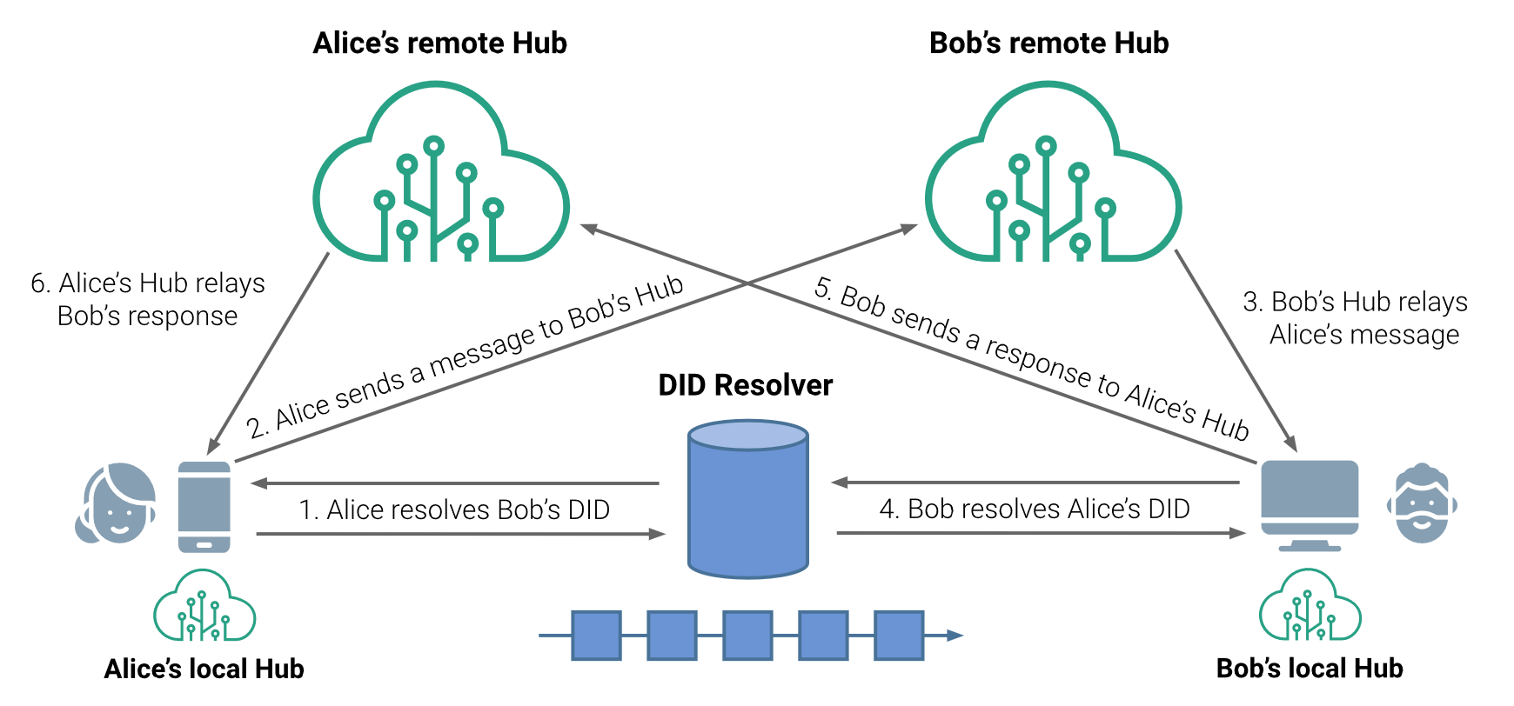
Identity Hub

Slide 6
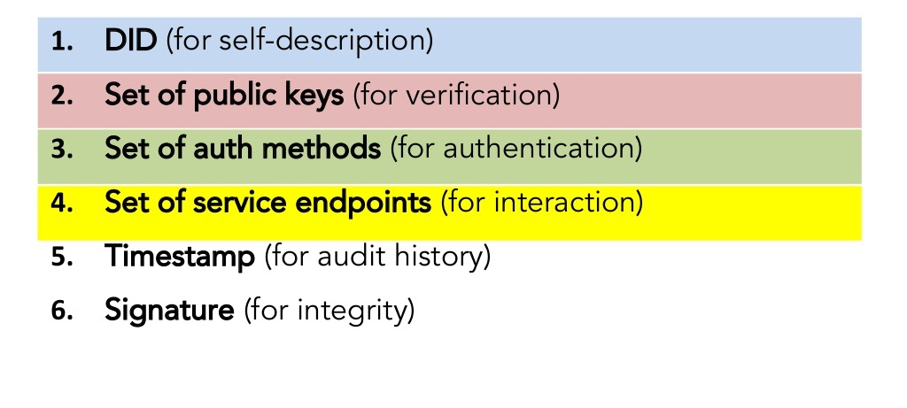
Decentralized Identifiers

Slide 7
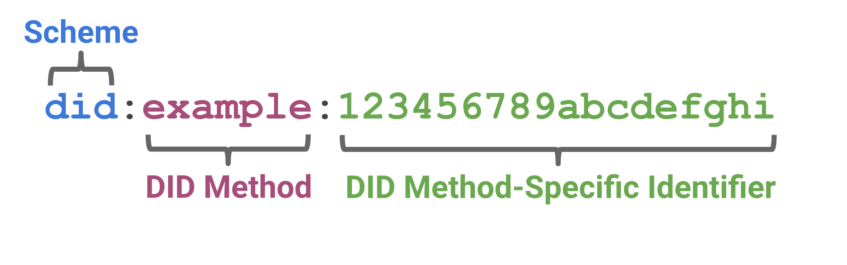
Decentralized Identifiers

Slide 8
Decentralized Identifiers – Document Example
{
"@context": [
"https://www.w3.org/ns/did/v1",
"https://w3id.org/security/suites/ed25519-2020/v1"
]
"id": "did:example:123456789abcdefghi",
"authentication": [{
"id": "did:example:123456789abcdefghi#keys-1",
"type": "Ed25519VerificationKey2020",
"controller": "did:example:123456789abcdefghi",
"publicKeyMultibase": "zH3C2AVvLMv6gmMNam3uVAjZpfkcJCwDwnZn6z3wXmqPV"
}]
}

Slide 9

1. Locate DID document
2. Read DID document
3. Verify VC signature
Verifiable Credential
Distributed infrastructure

Slide 10
What is did:web?
A new DID method that allows participants to bootstrap trust using a web domain's existing reputation.
{ "@context": "https://www.w3.org/ns/did/v1", "id": "did:web:example.com", "verificationMethod": [{ "id": "did:web:example.com#owner", "type": "Secp256k1VerificationKey2018", "owner": "did:web:example.com", "ethereumAddress": "0xb9c5714089478a327f09197987f16f9e5d936e8a" }], "authentication": [ "did:web:example.com#owner" ] }
did:web Method Specification (w3c-ccg.github.io)

Slide 11
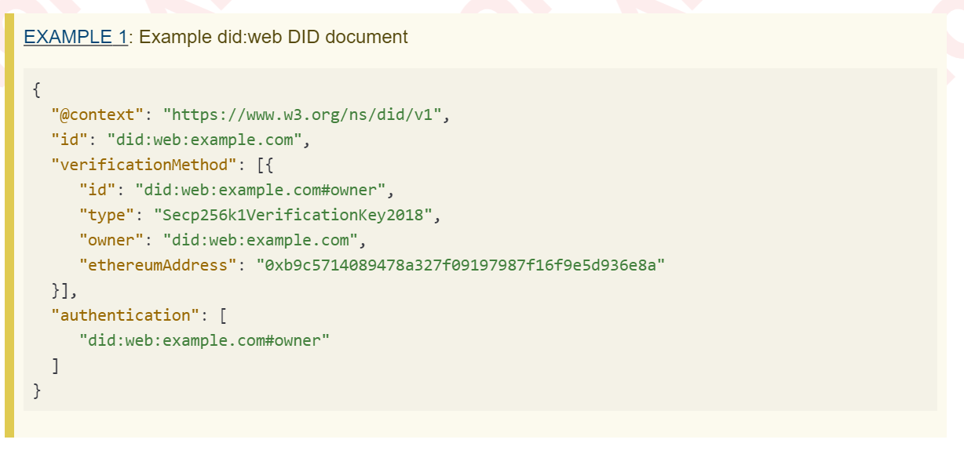
did:web:example.com
https://example.com/.well-known/did.json

Slide 12
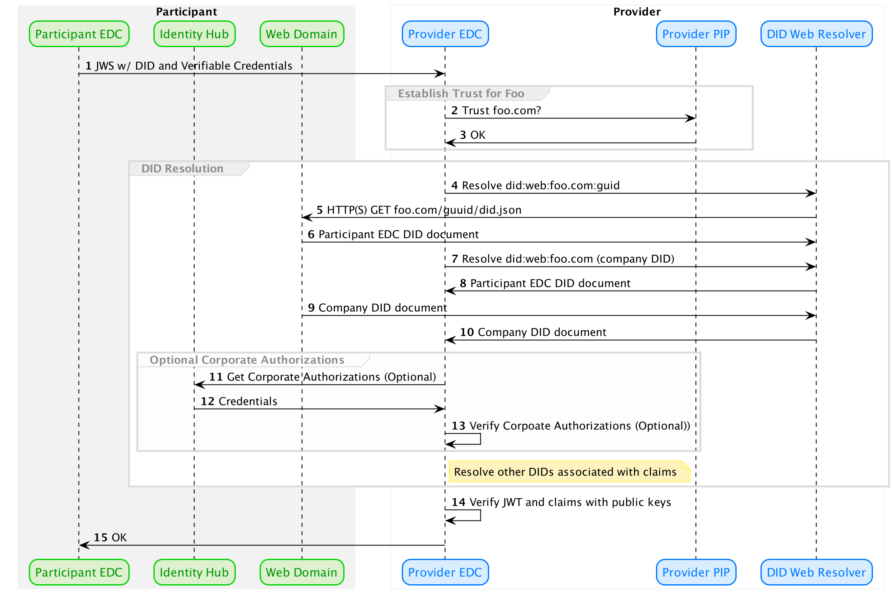

Slide 13
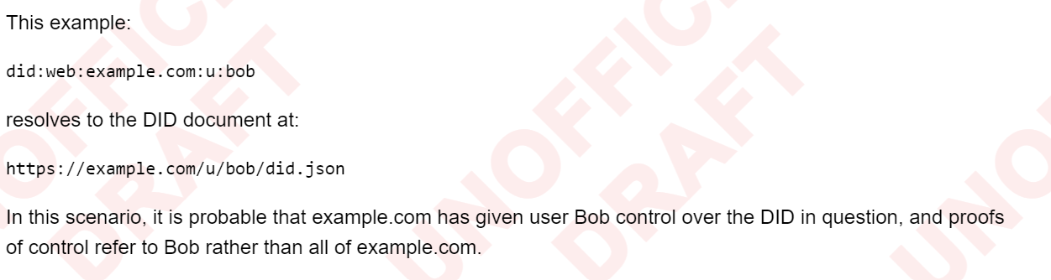
Considerations
DNS Security
DNS Over HTTPS
Optional Path and DID control?

Slide 14

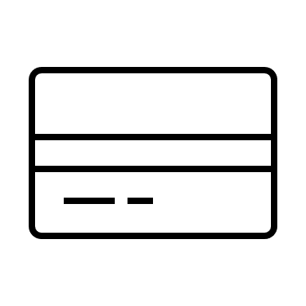

Putting it all together: Using identity hub
2. Store Verifiable Credential in Hub
Verifiable
Credential
Identity Hub (Issuer)
4. Query Hub for Verifiable Credential
Issuer
Verifier
1. Generate DID and write
DID:WEB
DID:WEB
3. Look up DID of issuer
"id": "did:example:123456789abcdefghi",
"authentication": [{
"id": "did:example:123456789abcdefghi#keys-1",
"type": "Ed25519VerificationKey2020",
Distributed infrastructure

Slide 15

Putting it all together: User initiated
Verifiable
Credential
Verifiable
Credential
Holder
Verifier
Issuer
DID
DID
"id": "did:example:123456789abcdefghi",
"authentication": [{
"id": "did:example:123456789abcdefghi#keys-1",
"type": "Ed25519VerificationKey2020",
Distributed infrastructure

Slide 16
Resources
DID-Web
did:web Method Specification (w3c-ccg.github.io)
W3C Verifiable Credentials
Verifiable Credentials Data Model 1.0 (w3.org)
DIF Identity Hub
DIF Identity Hub

